Slide 1
Inferential Statistics

Slide 2
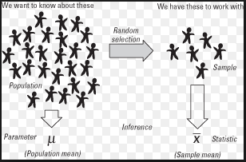
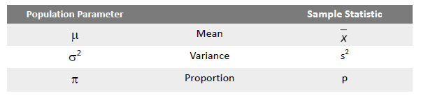
Inferential Statistics
Notes:
A Normal distribution is an important statistical data distribution pattern occurring in many natural phenomena, such as height, blood pressure, lengths of objects produced by machines, etc. Certain data, when graphed as a histogram( data on the horizontal axis, amount of data on the vertical axis), creates a bell shaped curve known as a normal curve, or normal distribution.
Normal distribution is symmetrical with a single central peak at the mean (average) of the data. The shape of the curve is described as bell-shaped with the graph falling off evenly on either side of the mean. Fifty percent of the distribution lies to the left of the mean and fifty percent lies to the right of the mean.

Slide 3

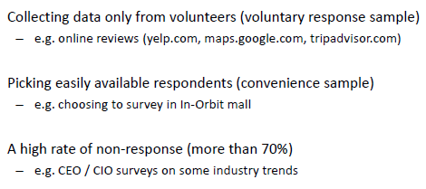
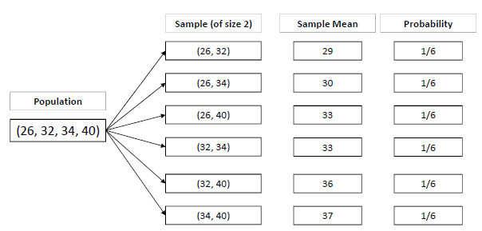

Sampling – How can it go wrong
Sampling variation
Notes:
A Normal distribution is an important statistical data distribution pattern occurring in many natural phenomena, such as height, blood pressure, lengths of objects produced by machines, etc. Certain data, when graphed as a histogram( data on the horizontal axis, amount of data on the vertical axis), creates a bell shaped curve known as a normal curve, or normal distribution.
Normal distribution is symmetrical with a single central peak at the mean (average) of the data. The shape of the curve is described as bell-shaped with the graph falling off evenly on either side of the mean. Fifty percent of the distribution lies to the left of the mean and fifty percent lies to the right of the mean.

Slide 4

STATISTICS
There are two types of statistics that are often referred to when making a statistical decision or working on a statistical problem.
Descriptive Statistics : Descriptive statistics utilize numerical and graphical methods to look for patterns in a data set, to summarize the information revealed in a data set, and to present the information in a convenient form that individuals can use to make decisions. The main goal of descriptive statistics is to describe a data set. Thus, the class of descriptive statistics includes both numerical measures (e.g. the mean or the median) and graphical displays of data
(e.g. pie charts or bar graphs).
Inferential Statistics: Inferential statistics utilizes sample data to make estimates, decisions, predictions, or other generalizations about a larger set of data. Some examples of inferential statistics might be a z statistics or a t-statistics

Slide 6
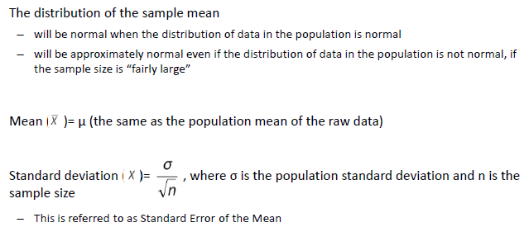
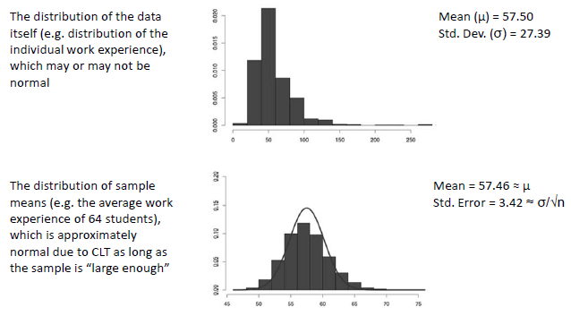

Central Limit Theorem
Thumb rule to check whether CLT can be applied
Notes:
A Normal distribution is an important statistical data distribution pattern occurring in many natural phenomena, such as height, blood pressure, lengths of objects produced by machines, etc. Certain data, when graphed as a histogram( data on the horizontal axis, amount of data on the vertical axis), creates a bell shaped curve known as a normal curve, or normal distribution.
Normal distribution is symmetrical with a single central peak at the mean (average) of the data. The shape of the curve is described as bell-shaped with the graph falling off evenly on either side of the mean. Fifty percent of the distribution lies to the left of the mean and fifty percent lies to the right of the mean.

Slide 7
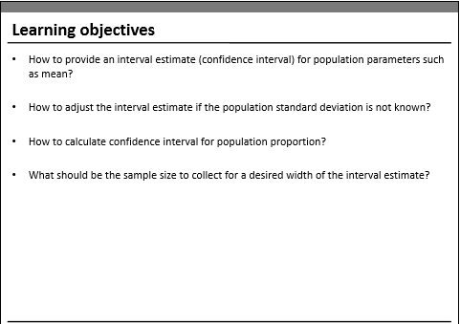
Confidence Intervals

Slide 8
Confidence Interval
What is the Probability of tomorrow’s temperature being 42 degrees exactly ?
Probability is ‘0’
Can it be between [-50⁰C & 100⁰C] ?
Notes:
A Normal distribution is an important statistical data distribution pattern occurring in many natural phenomena, such as height, blood pressure, lengths of objects produced by machines, etc. Certain data, when graphed as a histogram( data on the horizontal axis, amount of data on the vertical axis), creates a bell shaped curve known as a normal curve, or normal distribution.
Normal distribution is symmetrical with a single central peak at the mean (average) of the data. The shape of the curve is described as bell-shaped with the graph falling off evenly on either side of the mean. Fifty percent of the distribution lies to the left of the mean and fifty percent lies to the right of the mean.

Slide 9
Confidence Intervals
Sometimes samples don’t give quite the right result
Point estimators are valuable, but they may give
errors
Because we’re not dealing with the entire population, all we’re doing
is giving a best estimate. If the sample we use is unbiased, then the
estimate is likely to be close to the true value of the population
Specify a Range instead of single point of estimate

Slide 11

Credit card

Slide 12
Interval estimates of parameters
Based on sample data
− Can we trust this estimate ?
What do you think will happen if we took another random sample of 140 alumni ?
Because of this uncertainty, we prefer to provide the estimate as an interval (range) and associate a level of confidence with it
− The point estimate for mean balance = $1990
Interval Estimate =
Point Estimate ± Margin of Error
Thumb rule to check whether CLT can be applied
Notes:
A Normal distribution is an important statistical data distribution pattern occurring in many natural phenomena, such as height, blood pressure, lengths of objects produced by machines, etc. Certain data, when graphed as a histogram( data on the horizontal axis, amount of data on the vertical axis), creates a bell shaped curve known as a normal curve, or normal distribution.
Normal distribution is symmetrical with a single central peak at the mean (average) of the data. The shape of the curve is described as bell-shaped with the graph falling off evenly on either side of the mean. Fifty percent of the distribution lies to the left of the mean and fifty percent lies to the right of the mean.

Slide 13
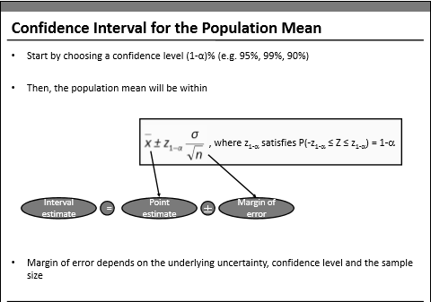

Slide 14
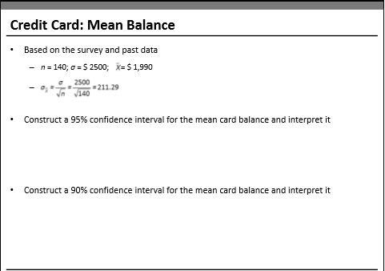
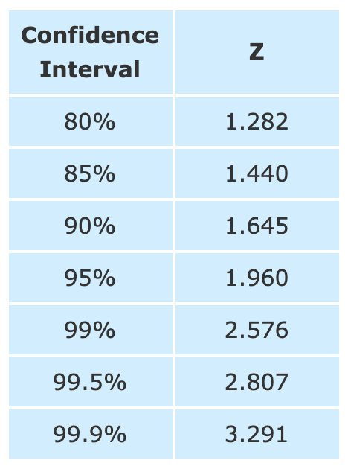
from scipy import stats
stats.norm.ppf(.975)

Slide 15
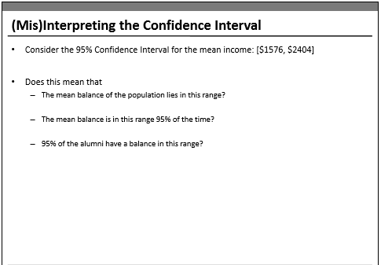

Slide 17
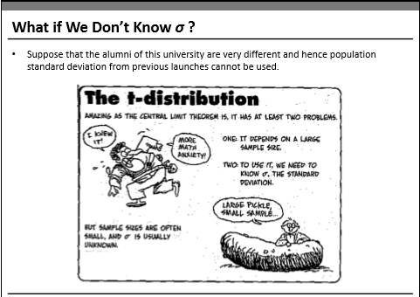

Slide 18
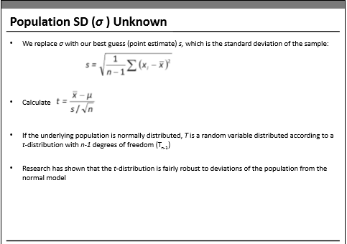

Slide 19
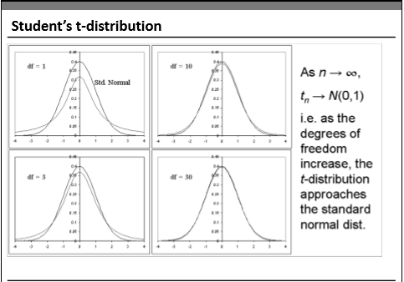

Slide 20
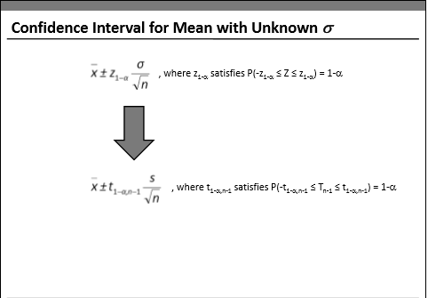

Slide 21
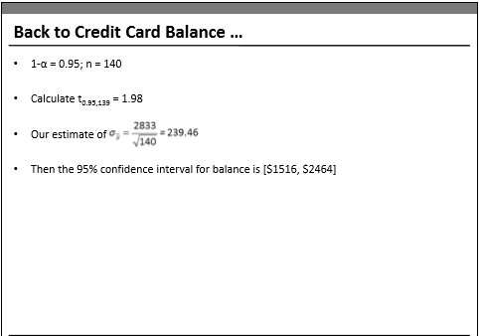
from scipy import stats
stats.t.ppf(0.975,df=139)

Slide 22
Thank you

